Slide 1
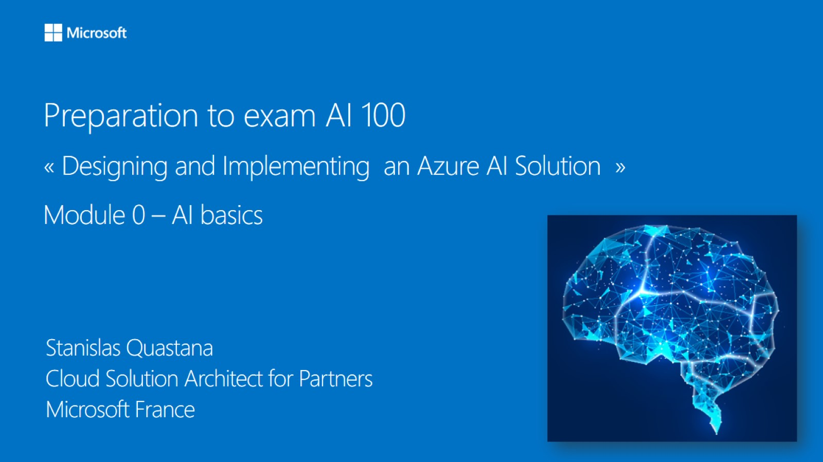

Meet Bhagdev
Program Manager, Azure
Microsoft

Slide 2
Contact me
Email: meetb@microsoft.com
Twitter: https://twitter.com/meet_bhagdev
GitHub: https://github.com/meet-bhagdev

Slide 3
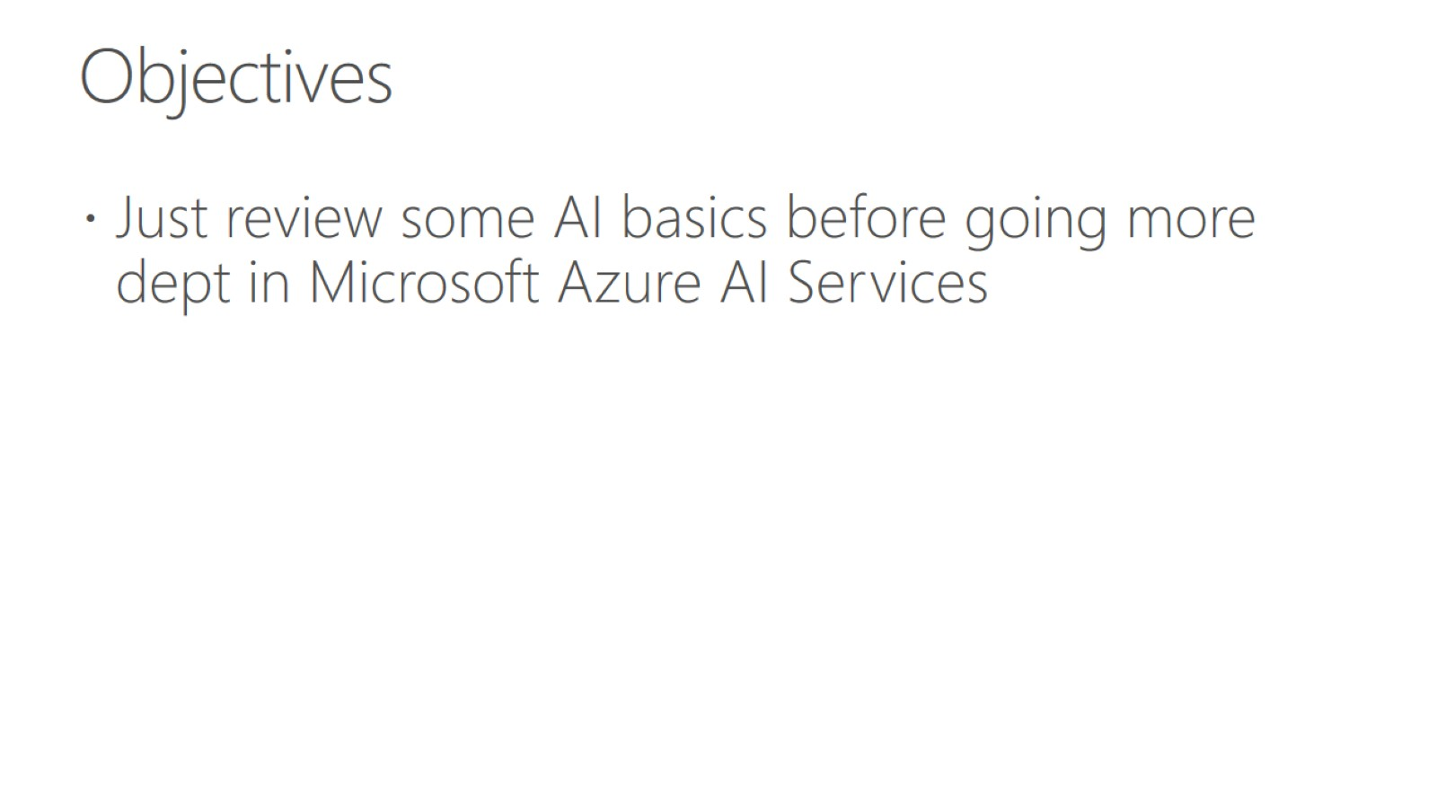
Objectives

Slide 4
Agenda - Prepare for the Microsoft AI 100 certification exam
December 9th – December 12th
Theory
Lots of hands on labs
Practice questions

Slide 5
What is the Microsoft AI 100 exam?
AI-100 Certification is for engineers who have intermediate to an expert level understanding of Machine Learning and are responsible for deploying end-to-end AI solutions on Azure using various AI & ML services.

Slide 6
Topics covered by AI-100
Azure Cognitives Services (a lot of questions)
Azure AI + AKS + ACI
Azure IoT Edge + Azure Stack + Azure DataBox Edge
IoT Hub + EventBus
Azure Storage
Azure Stream Analytics
Azure Functions + Azure Logic App
LUIS
Monitoring Apps & AI applications
Azure Bot Service + QnA Maker + Cognitives Services
Security (Authentication, Azure Key Vault)

Slide 7
What is AI?

Slide 8
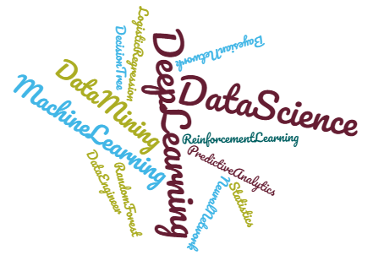

Many concepts

Slide 9
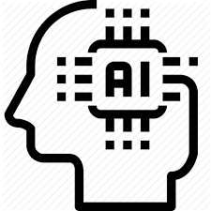


Three nested concepts
Artificial Intelligence
Machine Learning
Deep Learning
Artificial Intelligence: AI refers to scenarios where a machine mimics the cognitive functions associated with human minds.
Machine Learning: A subset of AI -- self-learning algorithms that detect patterns and anomalies. They get better as they consume more data (but that improvement will eventually level off, and more data will not lead to an increase in performance). Machine Learning does two things: It senses and predicts.
Deep Learning: A subset of Machine Learning. Deep learning is also best applied to problems centering around perception and language. To keep this simple, think of the concept of machine learning -- but when it comes to deep learning, there’s no ‘ceiling’ of improvement based on data ingestion. It continues to get better, and the only limitation is your ability to feed it more data. Here, you need massive computational power.

Slide 10
Big Data
Breakthroughs
Enabling
AI
Powerful Algorithms
Cloud Computing
Notes:
Percées technologiques qui ont permis l’essor de l’IA

Slide 11
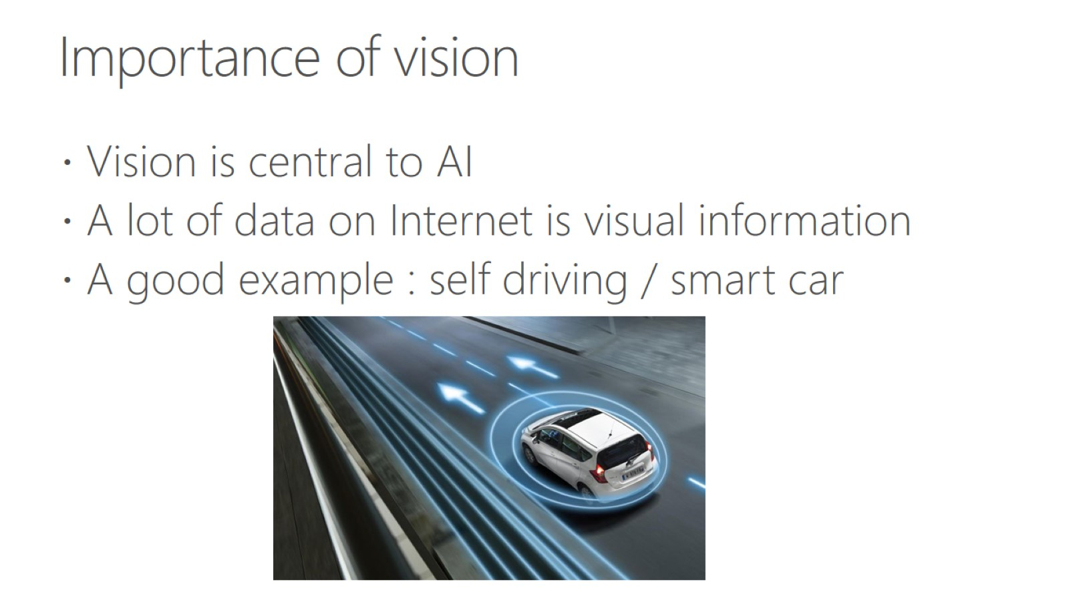
Importance of vision

Slide 12
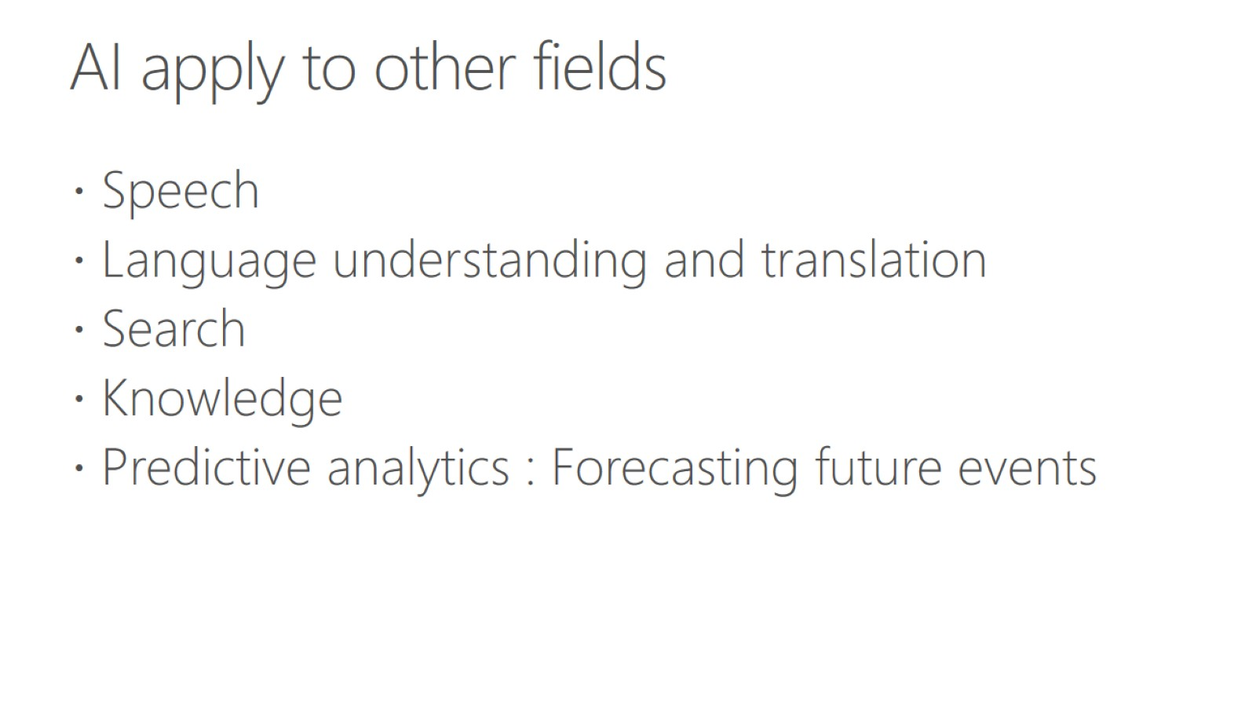
AI apply to other fields

Slide 13
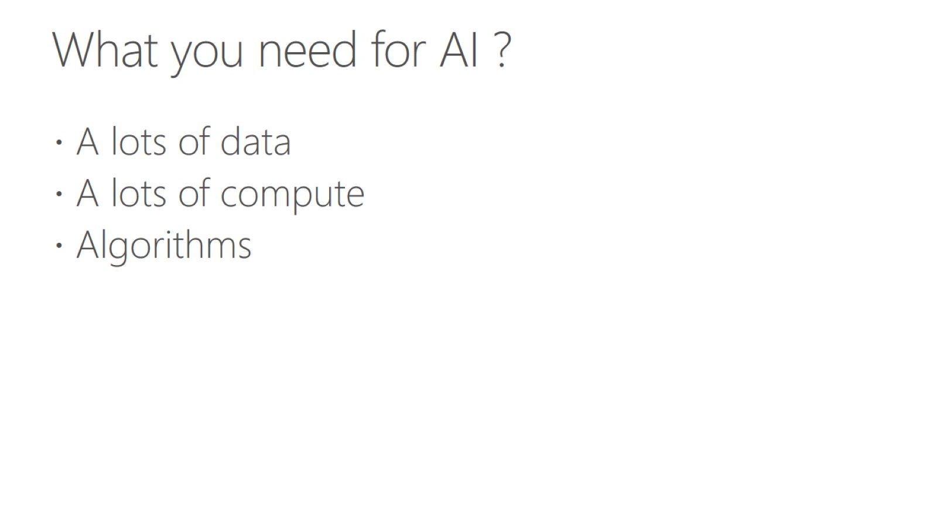
What you need for AI ?

Slide 14
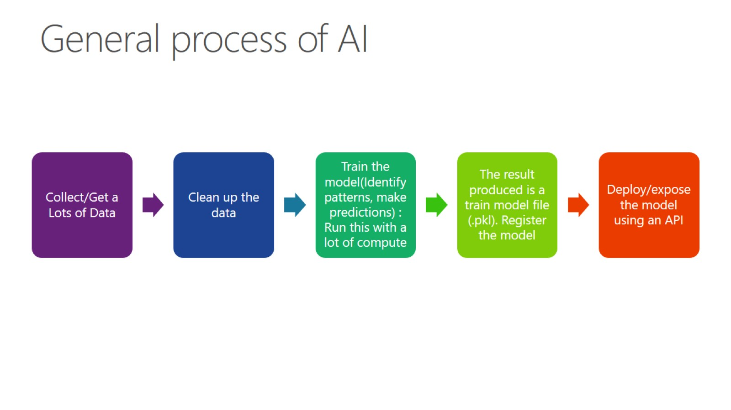
General process of AI

Slide 15
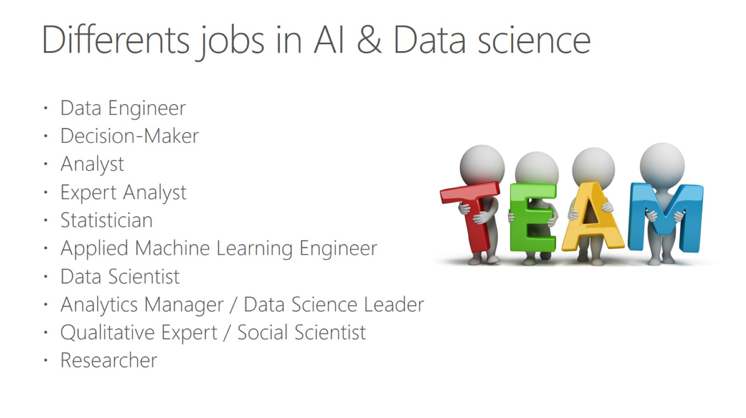
Differents jobs in AI & Data science

Slide 16
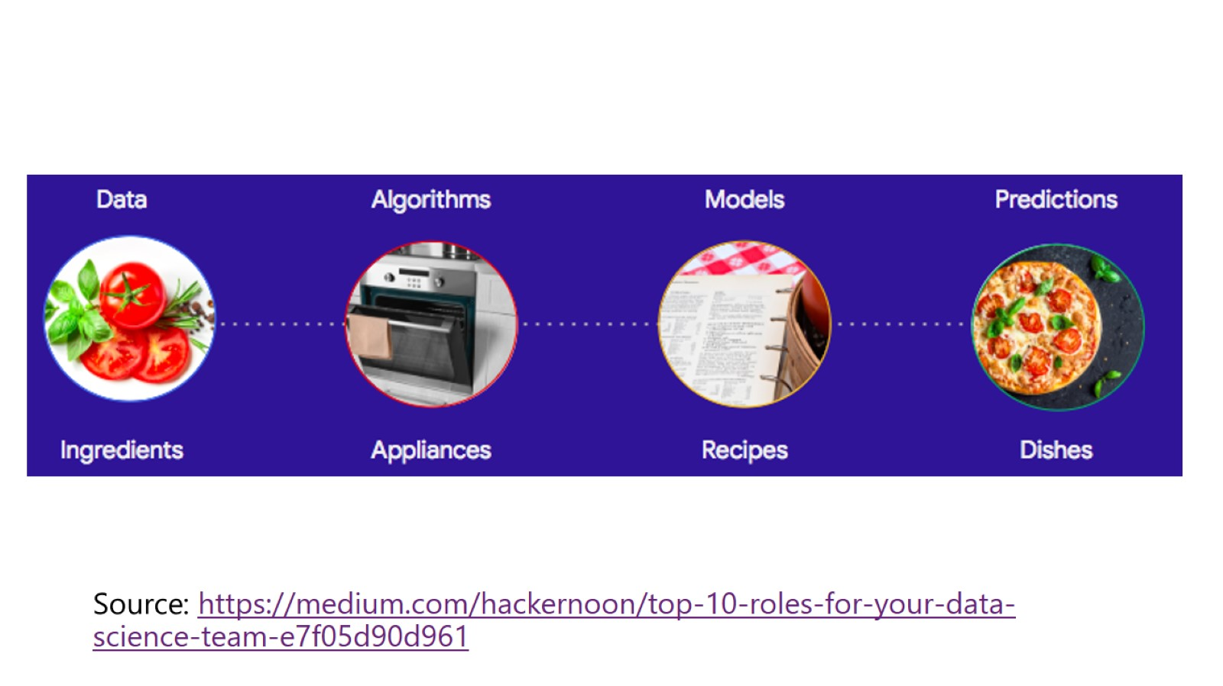

Slide 17
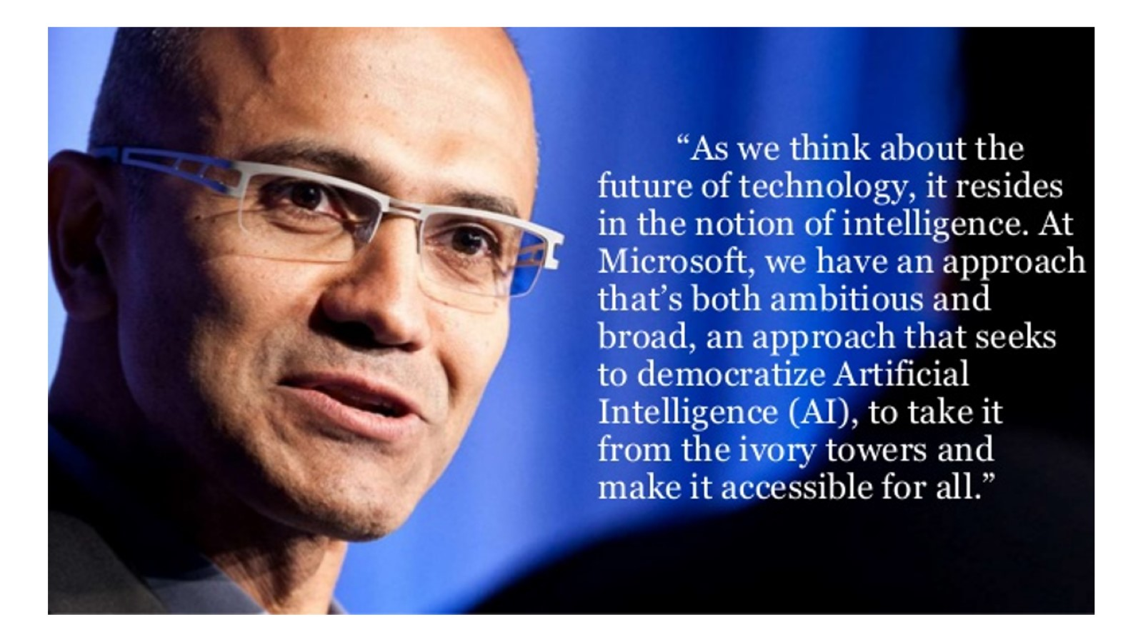

Slide 18
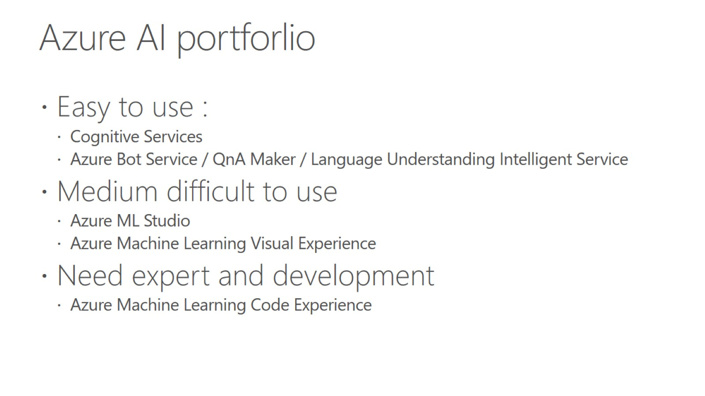
Azure AI portforlio

Slide 19
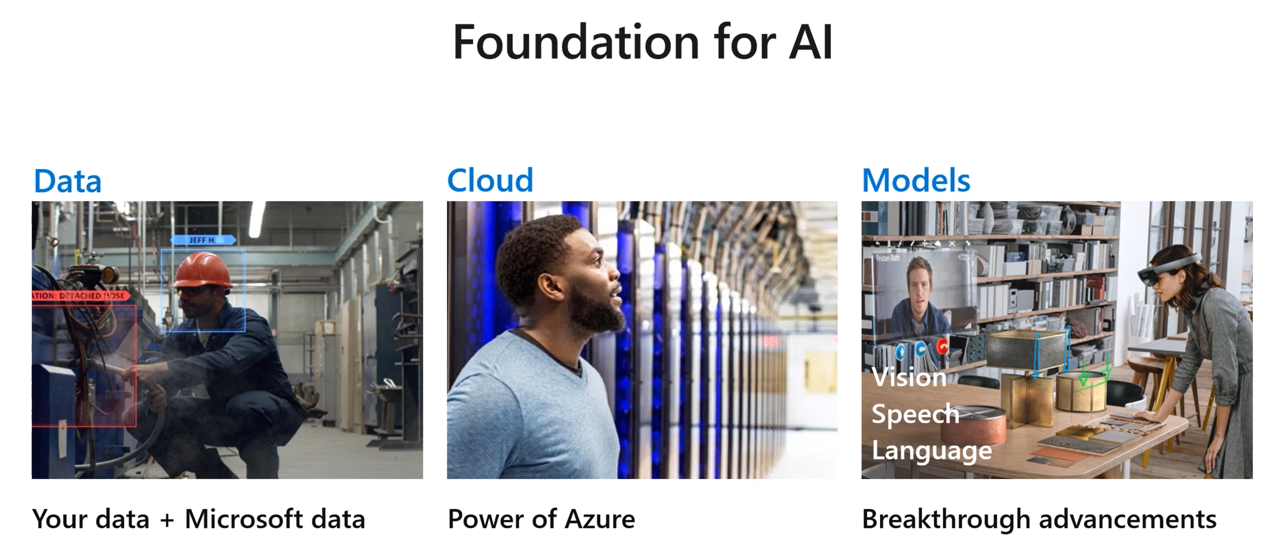
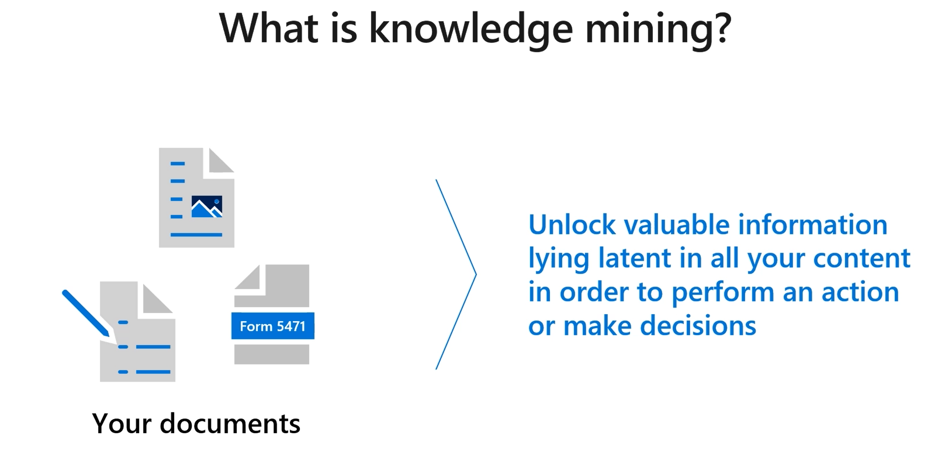
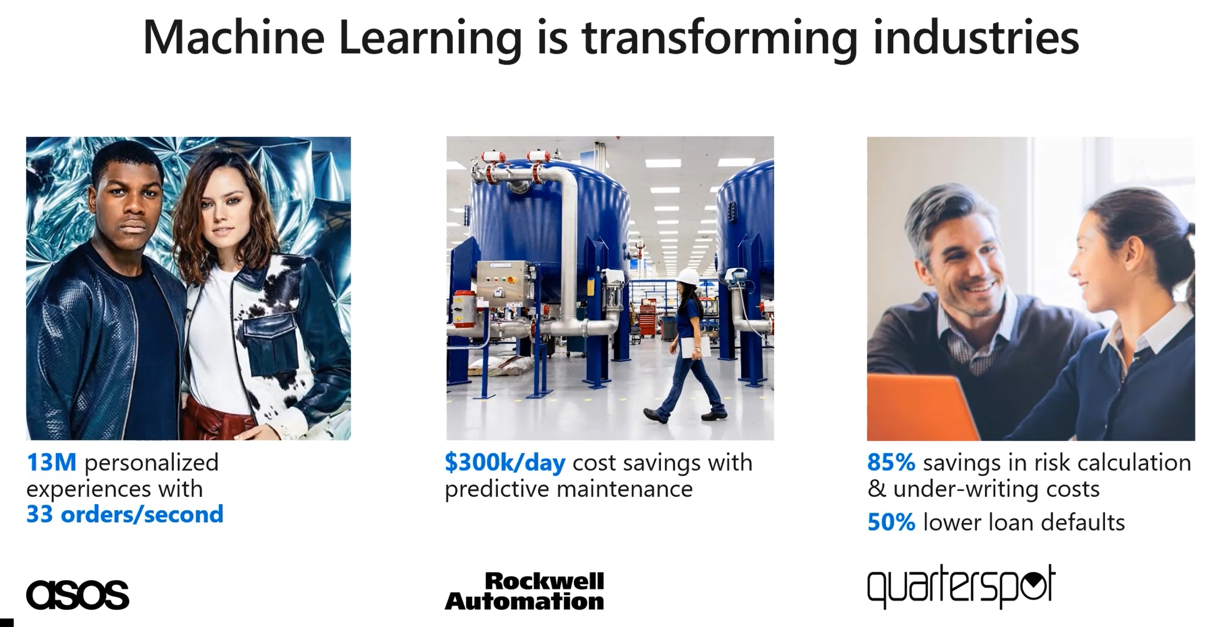
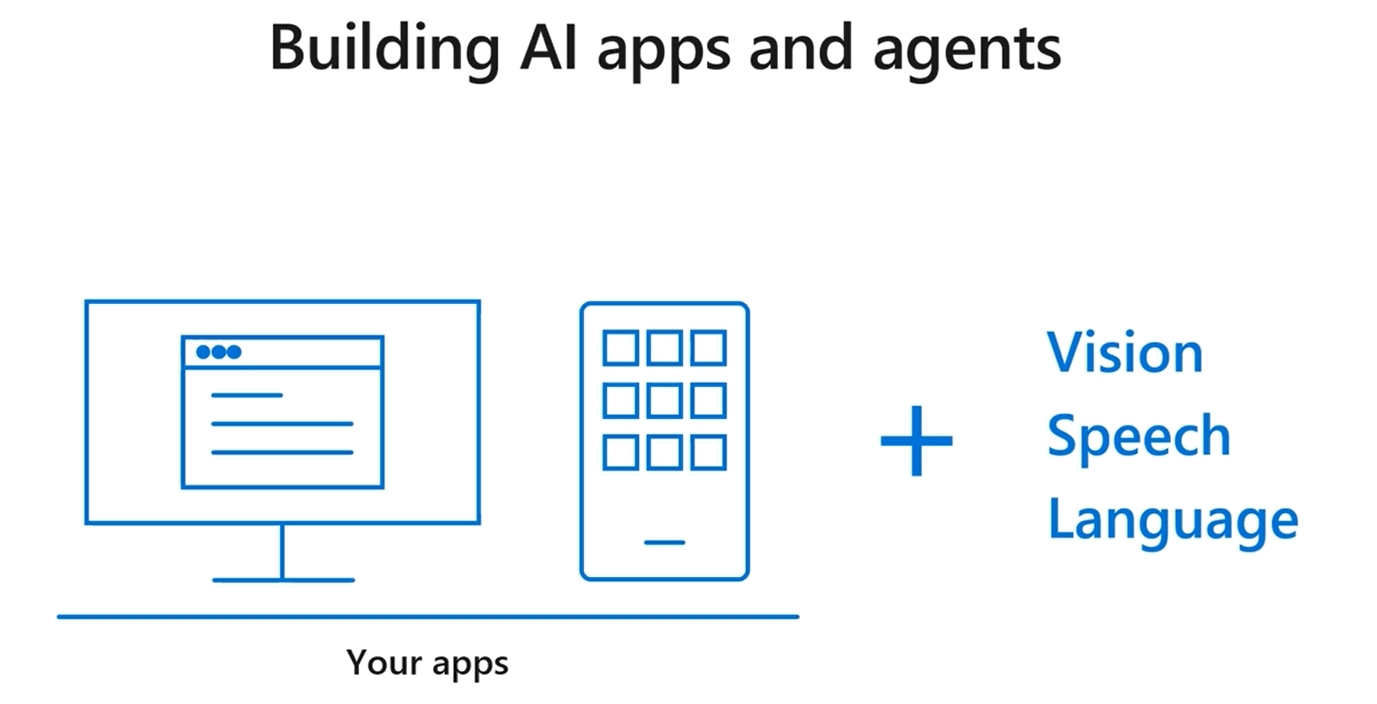
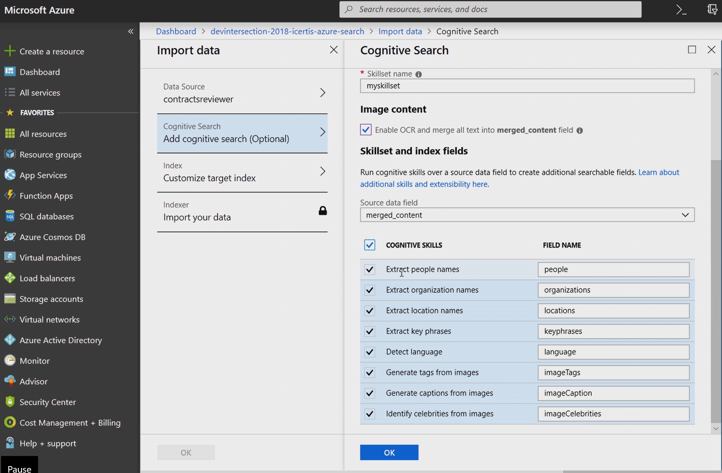
Understanding the concepts

